Slide 1
Machine Learning and Strategy Games
Building an Artificial Intelligence to Play Connect 4
Quinn Agabob
Ryan Burns
Spring 2023

Slide 2
Abstract
Our goal with this project was to design and implement an artificial intelligence to play a strategy game, as we wanted to work on an interesting use case for this emerging technology
Using a Python version of Connect 4 as a base for the project, we implemented a scoring system and used this to generate game data, which would later be used to train a machine learning algorithm
Screen interpretation and mouse movement was also implemented, so that our artificial intelligence would be able to interact with the game in a way similar to how a human might

Slide 3
Abstract
In the end, our artificial intelligence was successfully able to play Connect 4 by interpreting the screen and controlling the mouse in order to make moves on its own
This project was ultimately a great learning experience for us, since there were many new concepts that we needed to figure out how to implement throughout this process

Slide 4
Background: How We Chose This Topic
We both wanted to work on a project related to video games or board games, so building an AI to play these games was both an interesting and challenging option
Programming in Python was something that we both had in common, and we made significant use of the libraries available in Python throughout our project
Neither of us had a lot of previous experience with machine learning, so we wanted to take this opportunity to learn something new using a topic that we were both interested in

Slide 5
Research: Train Your Own Chess AI
A documented journey of a programmer making his own chess AI
We found this beneficial due of the similarity of our projects
While the implementation wasn't the exact same, the theories were
Provided knowledge on current day “super AIs” (Stockfish, Deep Blue, AlphaZero)
Gave us some insight on the process and steps that go into creating a machine learning artificial intelligence

Slide 6
Research: Machine Learning Made Easy: A Review of Scikit-learn Package in Python Programming Language
An article that we found during the research process that made the topic easier to understand
This made it a great starting point when working on the project
Uses Python and the scikit-learn library, which we were planning on using from an early point in the design process
Goes over some of the different methods and models

Slide 7
Research: Machine Learning: Hands-On for Developers and Technical Professionals
A book found during the research process that was designed for a high-tech audience
Provided some excellent information on machine learning theory
One negative of this resource was that there were no examples of Python code included

Slide 8
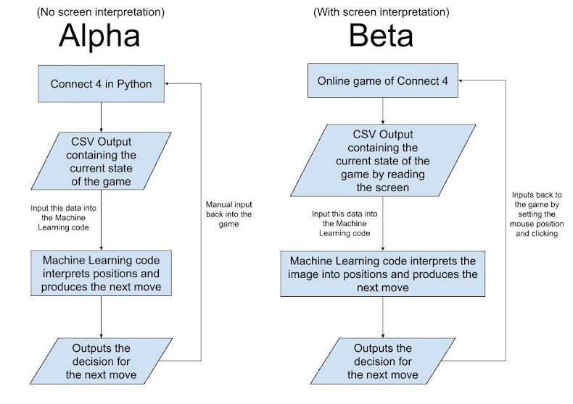
Project Design

Slide 9
Project Design
The Alpha stage of the project was all about creating a scoring system, collecting data, and using it to train a machine learning algorithm
We actually did not anticipate that the data would need to be created manually, so building the dataset generator ended up being a significant part of the Alpha stage and the project as a whole
The Beta stage was all about allowing the AI to interact with a website by moving the mouse and clicking, this remained generally unchanged from our initial idea of the project

Slide 10
Implementation
When implementing our project design, the final version was divided into two parts, the dataset generator and the artificial intelligence itself
Using the dataset generator, we are able to collect data on any number of completed Connect 4 games
The machine learning part of the artificial intelligence uses this data to determine which moves to make (Alpha)
The screen reading part of the artificial intelligence takes the desired move and inputs it on the online version of the game (Beta)

Slide 11
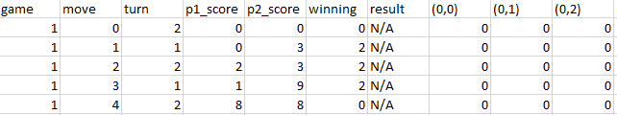
Final Product: Dataset Generator
The purpose of this part of the project was creating Connect 4 games to provide information that would be used in our machine learning models
Information that is collected after every move of every game:
Game number
Move number
Player turn
Player scores
Who is currently winning
The result of the game (if applicable)
The state of each position on the board (from left to right, top to bottom)

Slide 12
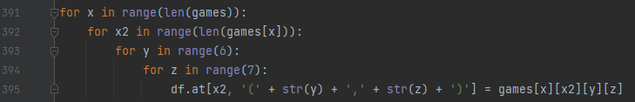
Final Product: Dataset Generator
In order to save the data, we must convert the game state data from 2D list into a dataframe
While the games are running, all information is saved into lists
After the games have finished running, convert the lists into a dataframe using a series of loops (shown below)
After the dataframe is complete, it is saved as a .csv file for later use with the machine learning algorithms

Slide 13
Final Product: Machine Learning
First, we assign the target (value we want to predict), and the features (values used to predict)
Target:
Score
Features:
Game state
Move number
Create a train test split
This is important because it evaluates if our model would be accurate for new data

Slide 14
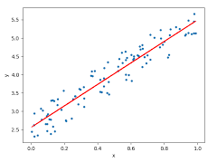
Final Product: Linear Regression
We created 3 different models so that we could choose the most accurate
Linear Regression
Predicts that the score can be
described as a straight line
y = mx + b
Score = (game state * turns) + intercept
https://en.wikipedia.org/wiki/Simple_linear_regression

Slide 15
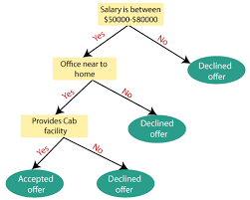
Final Product: Decision Tree Regressor
Decision Tree Regressor
A model that predicts the outcome based off of multiple variables
It splits data based off the value of features
https://towardsdatascience.com/machine-learning-basics-decision-tree-regression-1d73ea003fda

Slide 16
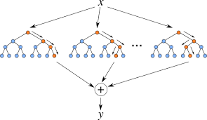
Final Product: Random Forest Regressor
Random Forest Regressor
One giant decision tree
Decision tree which can split off into other decision trees
Ensemble learning algorithm
Machine learning model comprised of multiple machine learning models
https://levelup.gitconnected.com/random-forest-regression-209c0f354c84

Slide 17
Which do you predict would be the most accurate?

Slide 18
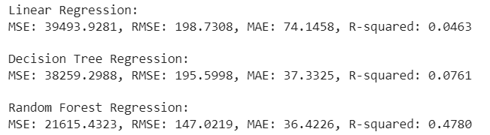
Final Product: Accuracy Scores

Slide 19
Final Product: Accuracy Scores
Accuracy models
Mean Squared Error (MSE)
Root Mean Squared Error (RMSE)
Mean Absolute Error (MAE)
R-squared (R²)
The MSE, RMSE and MAE scores are based off of the distance from predicted values to actual values
R² measures if the model is a good fit for the data

Slide 20
Final Product: Screen Reading
Uses Python libraries pillow (for screen interpretation) and mouse (for controlling the mouse input)
When the AI has made a decision about where to move, the mouse is positioned at a screen coordinate that corresponds with the correct column
In order to determine where the opponent has moved, the program compares the colors of pixels at the coordinates that correspond to valid moves on the board
When one of these is different than it was before, this is reflected in the game state within the program as well

Slide 21
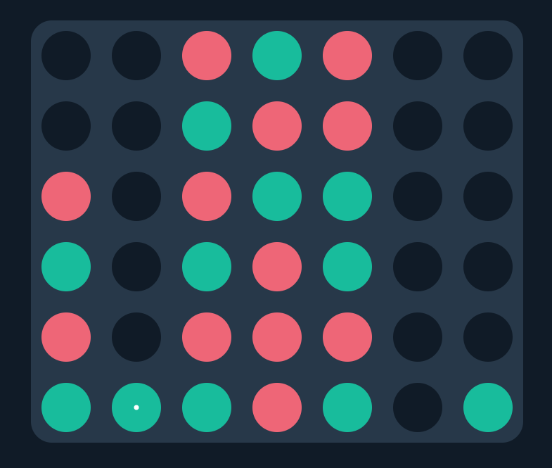
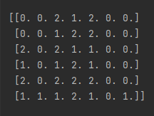
Final Product: Screen Reading
This allows the AI to always have an up-to-date interpretation of the board that is being displayed on screen

Slide 22
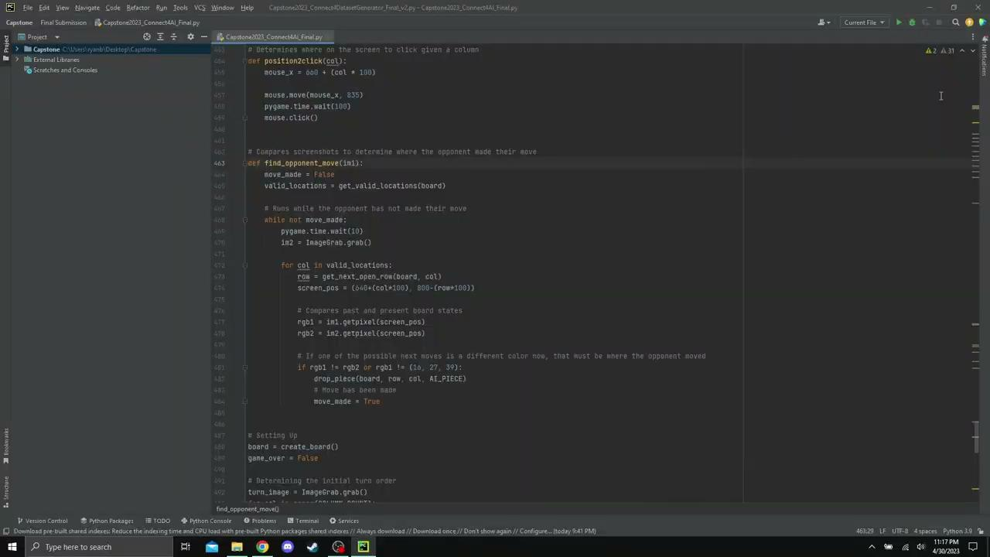
Video Demo

Slide 23
Questions?

